Slide 1
Friday 8th January
LO: To rehearse my writing by reading similar writing.

Slide 2
Friday 8th January LO: To rehearse my writing by reading similar writing.
Next week you are going to write a speech to explain whether you would prefer to life in the Stone Age or the Metal Ages.

Slide 3
Friday 8th January LO: To rehearse my writing by reading similar writing.
What is a speech?
A speech is a talk delivered to an audience.
In a speech you can share facts and your opinions about them.

Slide 4
Friday 8th January LO: To rehearse my writing by reading similar writing.
What is a speech?
A speech is a talk delivered to an audience.
In a speech you can share facts and your opinions about them.

Slide 5
Friday 8th January LO: To rehearse my writing by reading similar writing.
What are facts?
What are opinions?
An opinion is your own view about something, but it is not necessarily a fact.
A fact is something that has been proven to be true.

Slide 6
Friday 8th January LO: To rehearse my writing by reading similar writing.
What are facts?
What are opinions?
An opinion is your own view about something, but it is not necessarily a fact.
A fact is something that has been proven to be true.

Slide 7
Friday 8th January LO: To rehearse my writing by reading similar writing.
What are facts?
What are opinions?
An opinion is your own view about something, but it is not necessarily a fact.
A fact is something that has been proven to be true.

Slide 8
Friday 8th January LO: To rehearse my writing by reading similar writing.
What else do you think a good speech might need?

Slide 9
Friday 8th January LO: To rehearse my writing by reading similar writing.
contrastive conjunctions to compare different things
correct tenses
What else do you think a good speech might need?
expanded noun phrases and exciting language to add interest

Slide 10
Friday 8th January LO: To rehearse my writing by reading similar writing.
I would rather live in modern times than in Victorian times!
I would rather live in modern times than Victorian times because I think there is much more choice for children now. Now we have better toys and clothes. Importantly, we also have toilets inside our homes!
Victorian children’s toys were usually made from wood, metal or paper but now we can also make children’s toys from plastic. Victorian toys were quite simple however, we now have colourful, exciting and even electronic toys. In Victorian times some children’s toys may have had sharp, rough edges and been dangerous. In contrast, in modern times, toy makers must make sure that they are safe.
Read the beginning of this speech. Do you notice contrastive conjunctions, past tense verbs, facts and opinions?

Slide 11
Friday 8th January LO: To rehearse my writing by reading similar writing.
Opinion
I would rather live in modern times than in Victorian times!
I would rather live in modern times than Victorian times because I think there is much more choice for children now. Now we have better toys and clothes. Importantly, we also have toilets inside our homes!
Victorian children’s toys were usually made from wood, metal or paper but now we can also make children’s toys from plastic. Victorian toys were quite simple however, we now have colourful, exciting and even electronic toys. In Victorian times some children’s toys may have been made with sharp, rough edges and been dangerous. In contrast, in modern times, toy makers must make sure that they are safe.
past tense verbs are used when writing about Victorian times because they are in the past (they have already happened).
Facts

Slide 12
Friday 8th January LO: To rehearse my writing by reading similar writing.
What does a good speech need?
Facts
Opinion
Conjunctions
Correct tenses

Slide 13
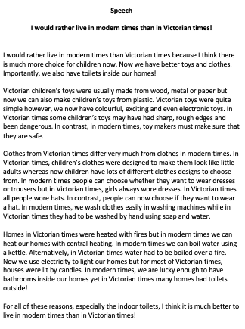
Friday 8th January LO: To rehearse my writing by reading similar writing.
Continue to read the speech on your sheet.
Can you spot:
contrastive conjunctions,
past tense verbs, facts and opinions?
If you can, print off the sheet and underline and label the key features.

